Slide 1
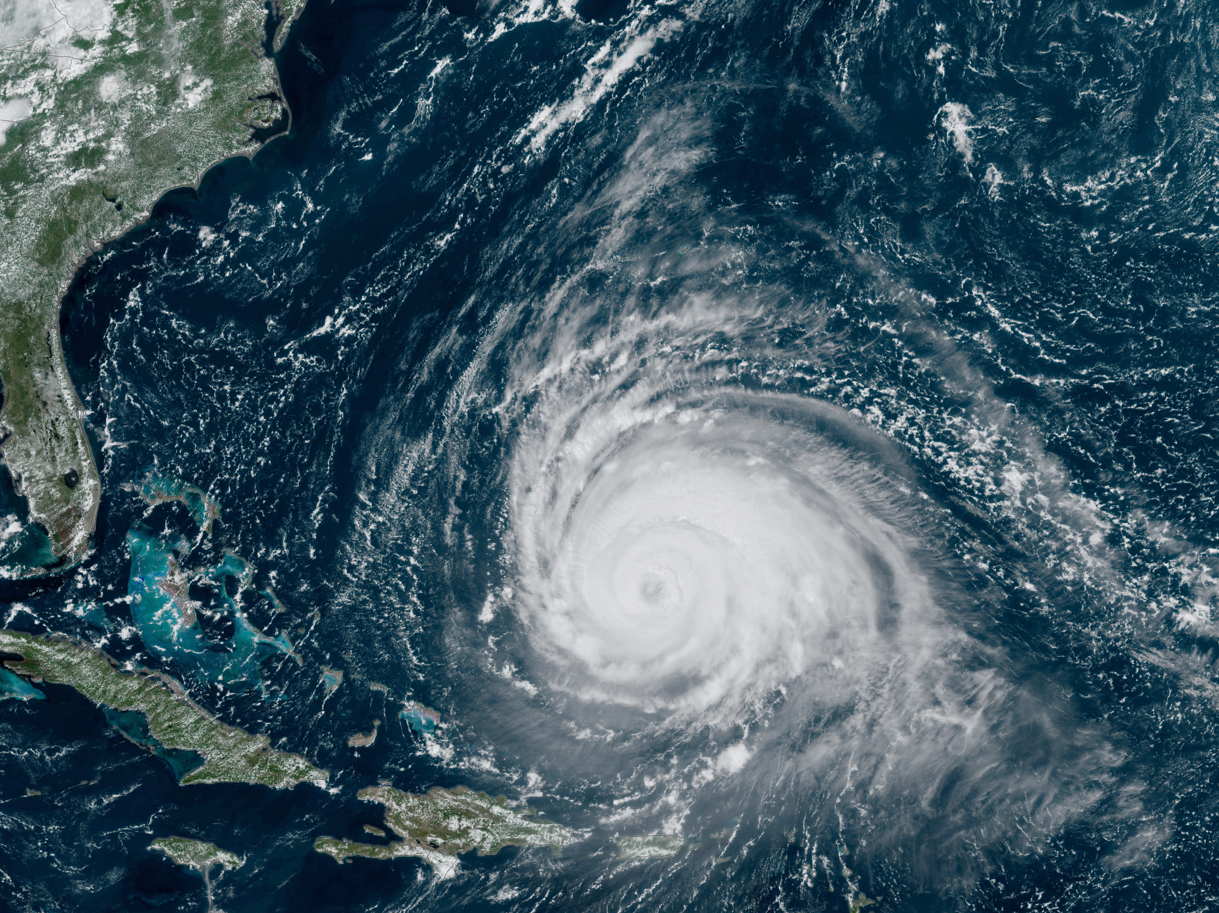
ATM 651 Guest Lecture Primary Circulation in Hurricanes: Gradient and Thermal Wind Balance
10/2/23

Slide 2
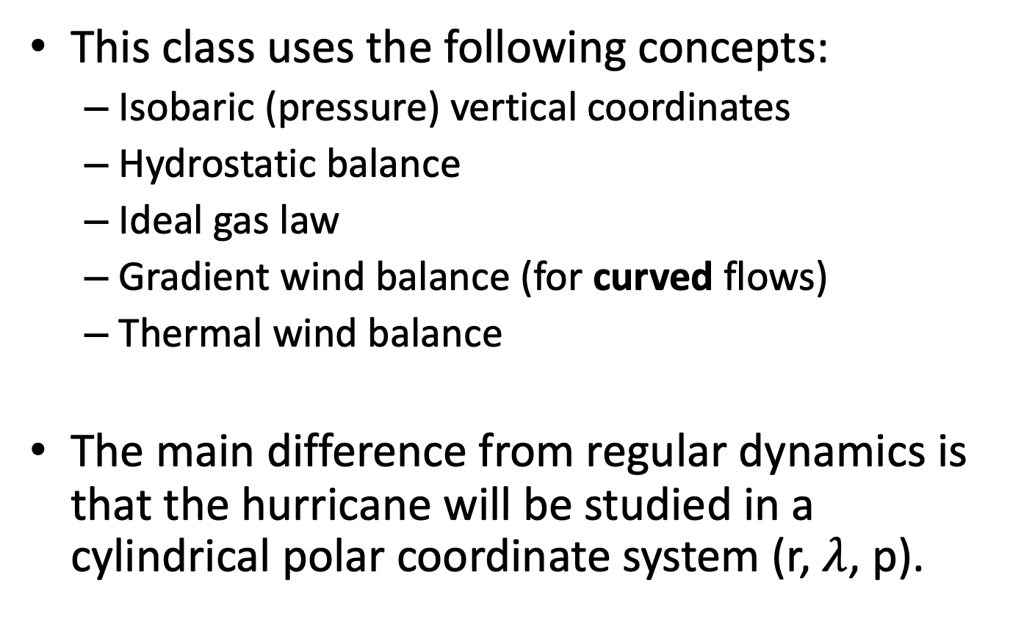
Preamble
This class uses the following concepts:
Isobaric (pressure) vertical coordinates
Hydrostatic balance
Ideal gas law
Gradient wind balance (for curved flows)
Thermal wind balance
The main difference from regular dynamics is that the hurricane will be studied in a cylindrical polar coordinate system (r, $λ$, p).

Slide 3
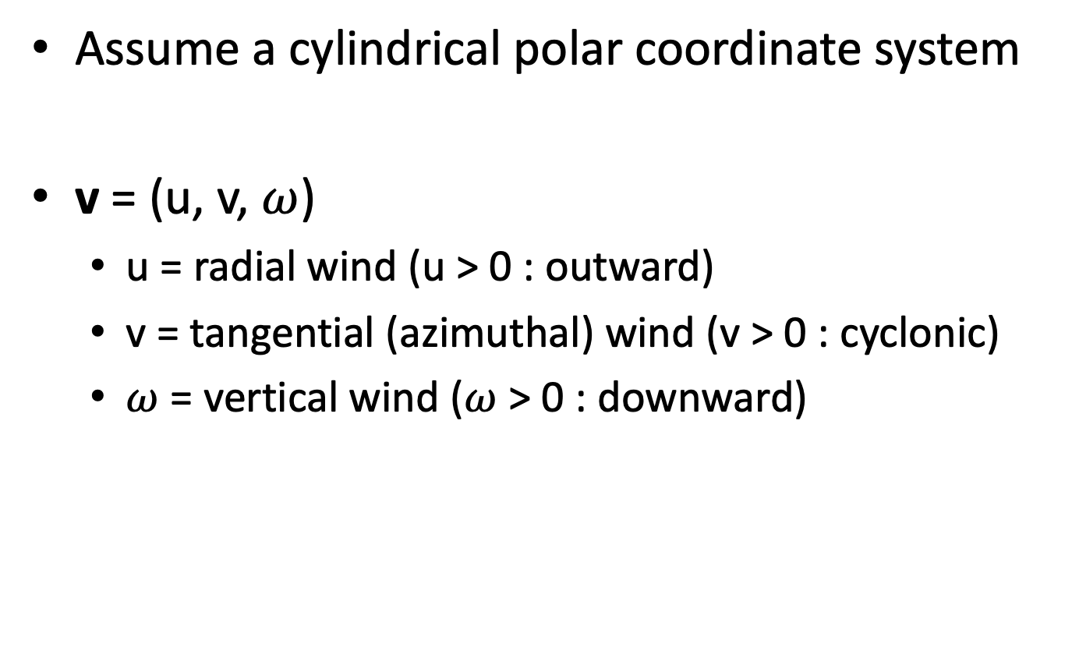
Wind in Hurricanes
Assume a cylindrical polar coordinate system
v = (u, v, $ω$)
u = radial wind (u > 0 : outward)
v = tangential (azimuthal) wind (v > 0 : cyclonic)
$ω$ = vertical wind ($ω$ > 0 : downward)

Slide 4
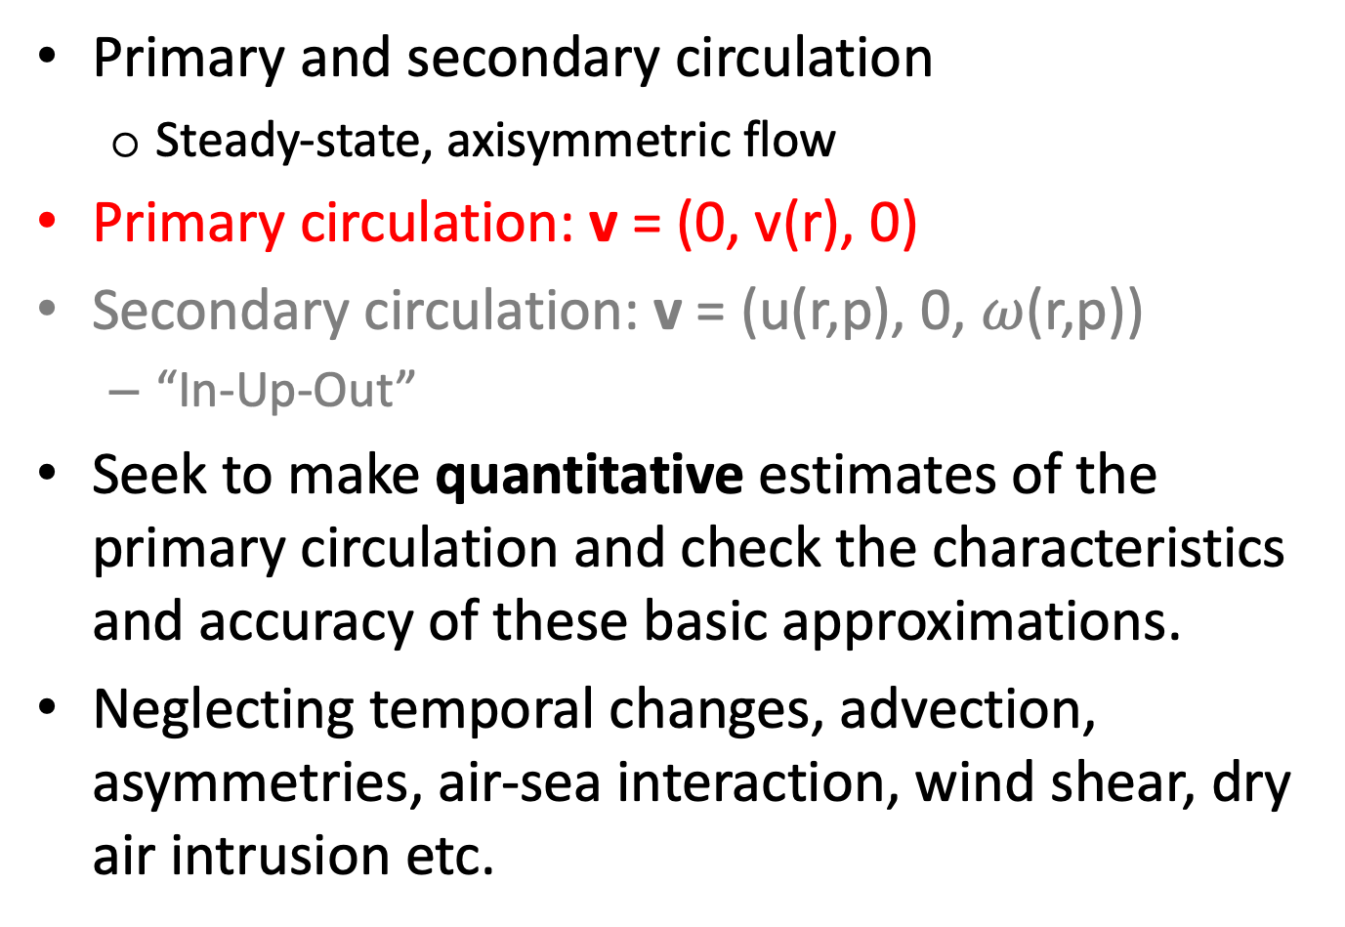
Wind in Hurricanes
Primary and secondary circulation
Steady-state, axisymmetric flow
Primary circulation: v = (0, v(r), 0)
Secondary circulation: v = (u(r,p), 0, $ω$(r,p))
“In-Up-Out”
Seek to make quantitative estimates of the primary circulation and check the characteristics and accuracy of these basic approximations.
Neglecting temporal changes, advection, asymmetries, air-sea interaction, wind shear, dry air intrusion etc.

Slide 5
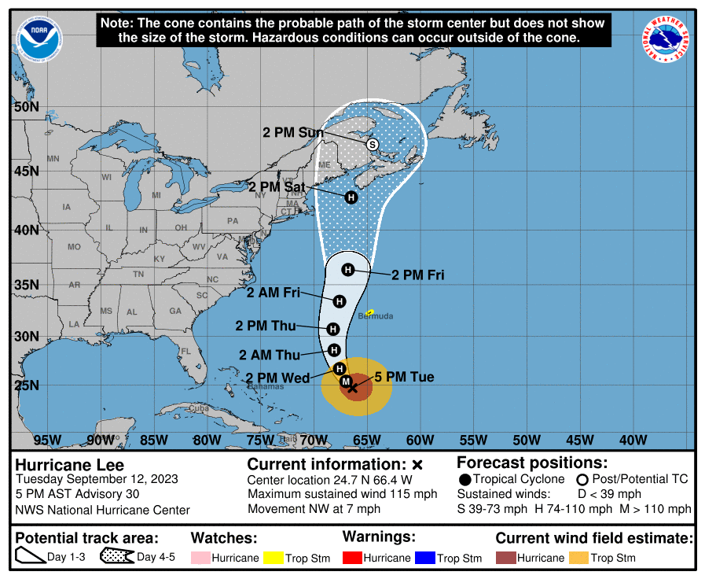
Hurricane Lee (2023)

Slide 6
Hurricane Lee (2023)
Following slides:
Outputs from analyses (not forecasts) of NOAA’s new HAFS-A model
From Weathernerds and Tropical Tidbits
Important fields:
Geopotential height Z, Wind v, Temperature T
No grid lines!
Assume distance between wind barbs ~30 km.

Slide 7
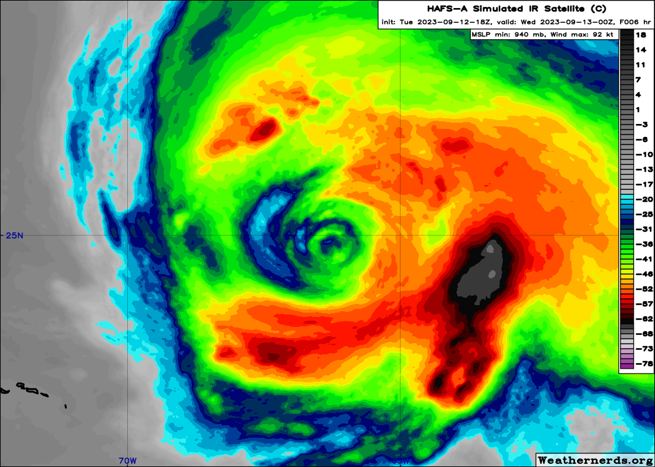
Hurricane Lee (2023)

Slide 8
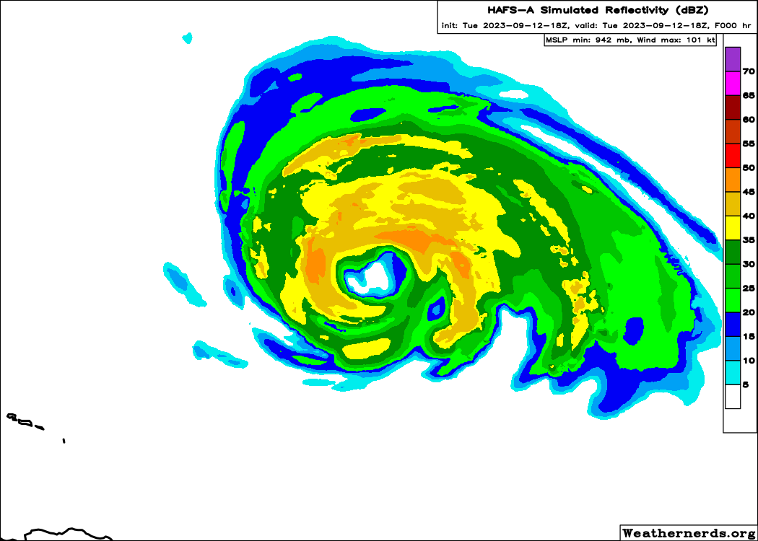
Hurricane Lee (2023)

Slide 9
Gradient Wind Balance
PGF = CeF + CoF
Motion v
CeF
L
PGF
CoF

Slide 10
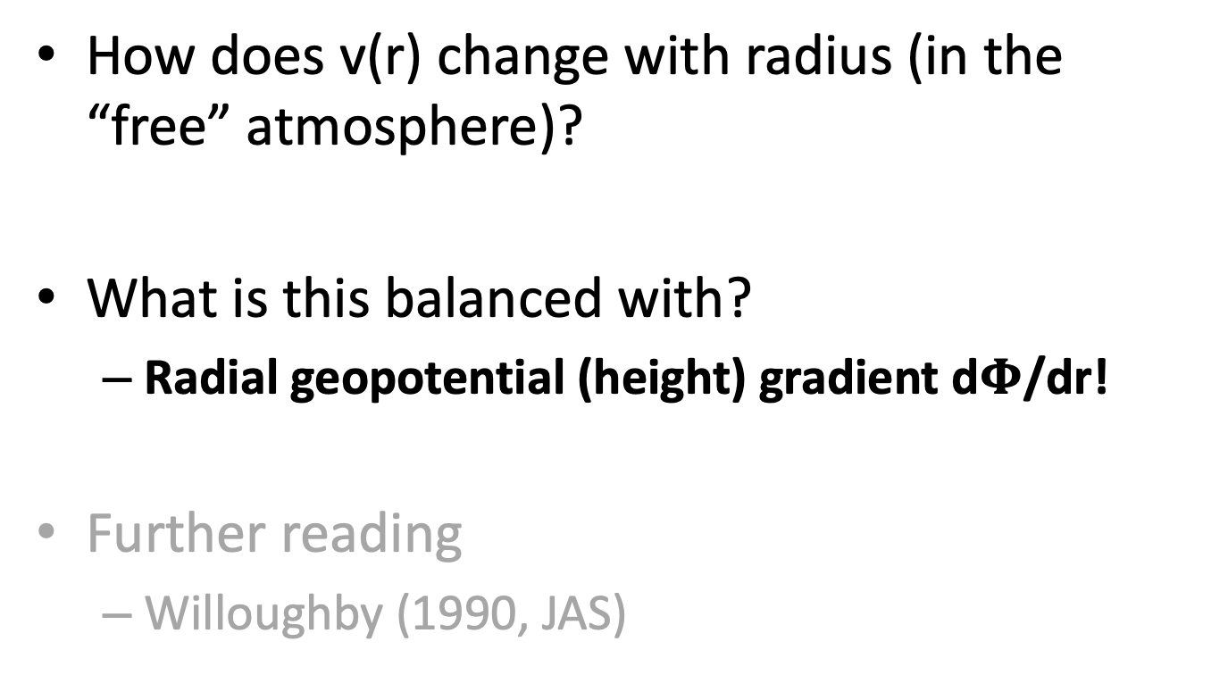
Gradient Wind Balance
How does v(r) change with radius (in the “free” atmosphere)?
What is this balanced with?
Radial geopotential (height) gradient d$Φ$/dr!
Further reading
Willoughby (1990, JAS)

Slide 11
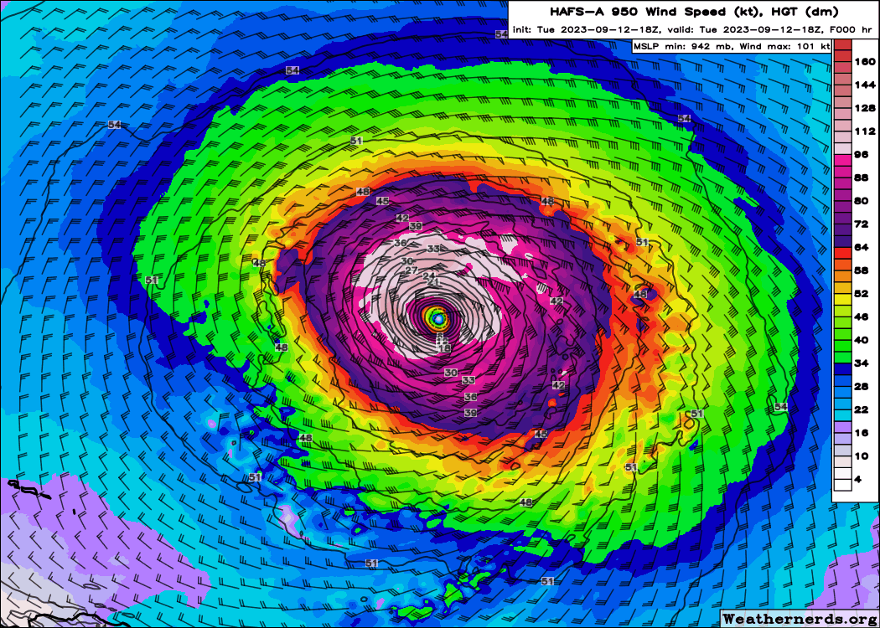

Slide 12
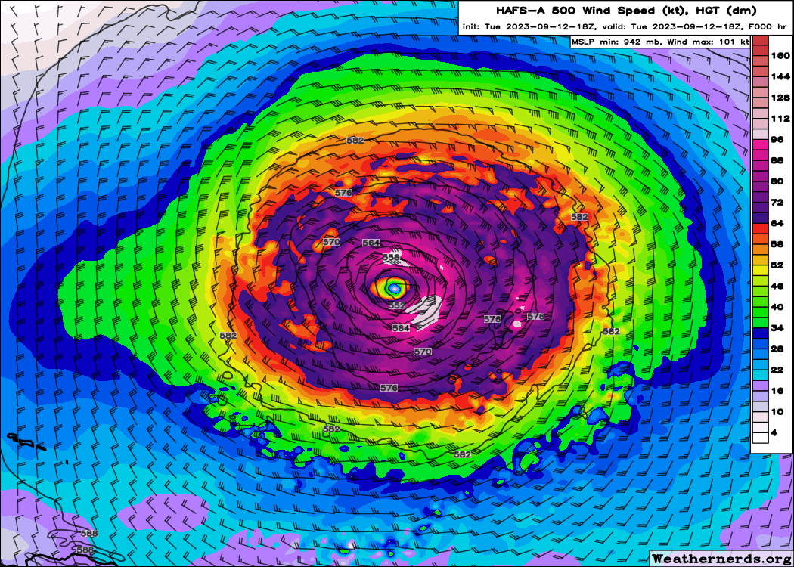

Slide 13
Thermal Wind Balance
How does v(r) change with height (in the “free” atmosphere)?
What is this balanced with?
Radial temperature gradient dT/dr
A strong radial temperature gradient implies that the wind will change sharply with height!

Slide 14
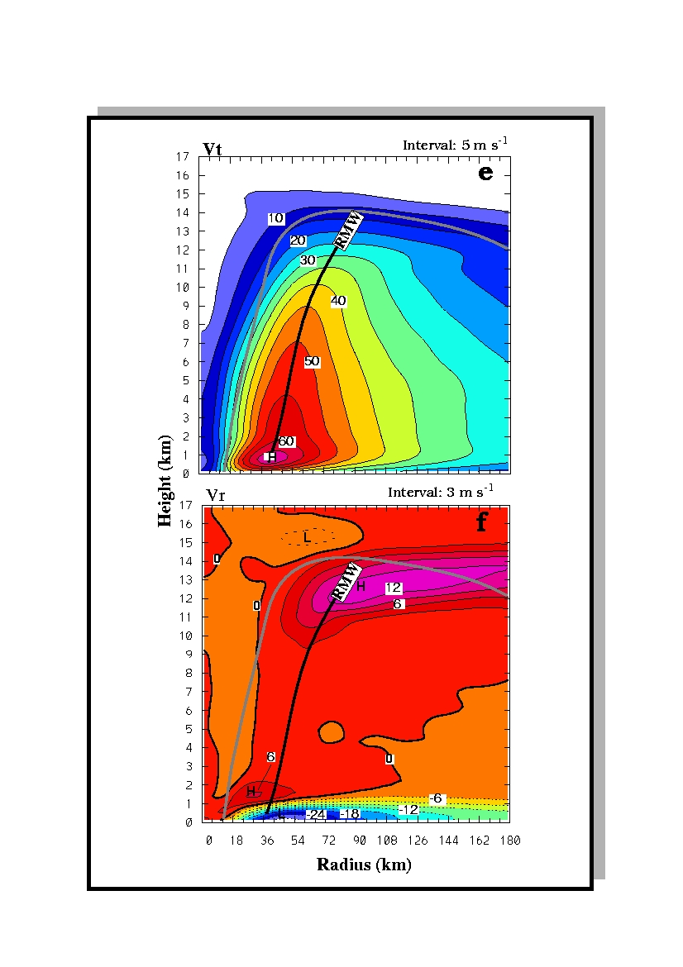
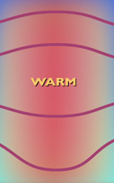

Slide 15
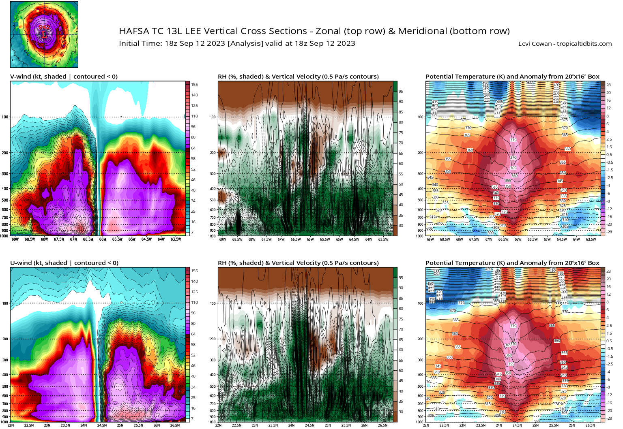

Slide 17
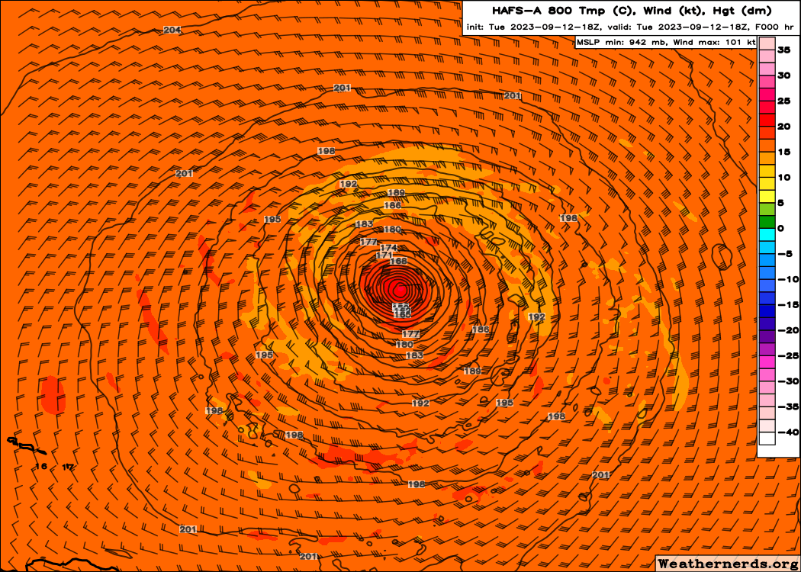

Slide 18
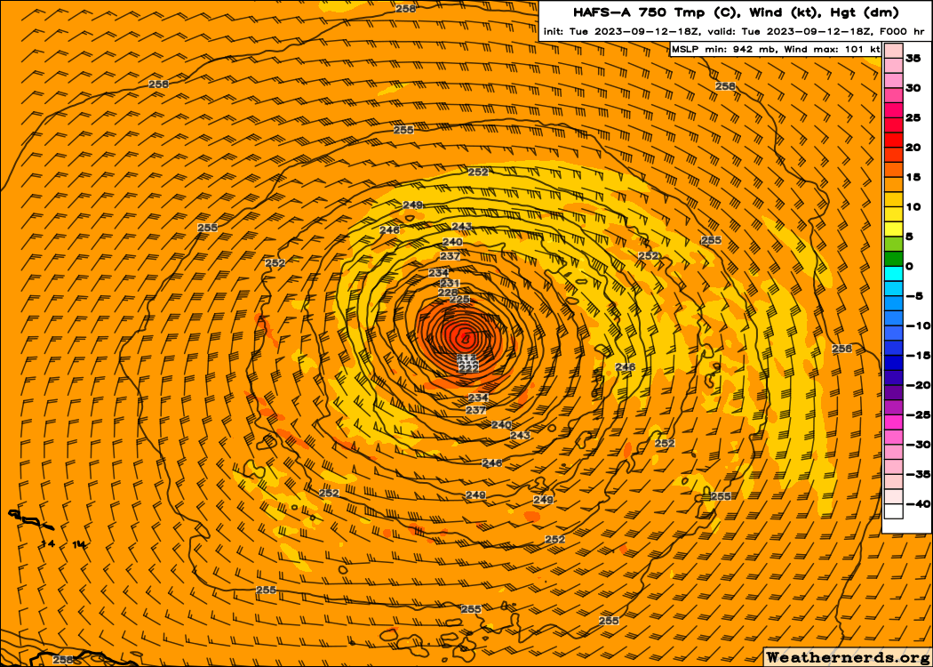

Slide 19
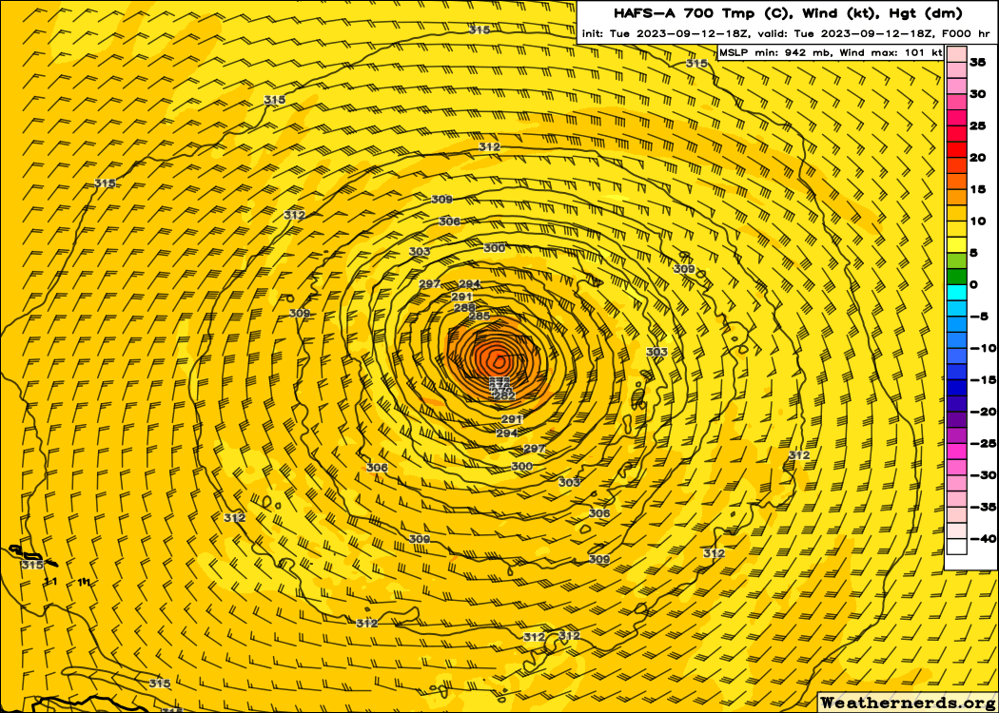

Slide 20
Secondary Circulation
“In – Up – Out”
Radial and Vertical Flow
Forced by heating and angular momentum
Sustains primary circulation against friction and radiative cooling
Tries to restore TC to balance
Controls distribution of hydrometeors, radar reflectivity
Also an axisymmetric, balanced circulation

Slide 21
Outflow
Upward motion
Inflow

